Slide 1

Future Faces of Physics Jeopardy!
Jeopardy!

Slide 2
Fabulous
Fields
Rock & Roll
Physics
What’s in
a Name
Extreme
Planets
Pop
Culture
100
100
100
100
100
200
200
200
200
200
300
300
300
300
300
400
400
400
400
400
500
500
500
500
500

Slide 3
Of all the science disciplines, this “life” science has the most women in faculty positions (>20%).
Fabulous Fields - 100

Slide 4
Over 40% of students that major in physics and another field have their second major in this quantitative field.
Fabulous Fields - 200

Slide 5
Females make up ~5% of the full professors in physics departments.
In this ancient and closely-related field, that number is doubled.
Fabulous Fields - 300

Slide 6
Of astrophysics, condensed matter physics, and plasma physics, the most physics PhDs are awarded for work in this subfield.
Fabulous Fields - 400

Slide 7
In 1988, the U of WI and Wayne State offered the first accredited programs in this high-paying field of applied physics.
Fabulous Fields - 500

Slide 8
Of diamond, graphite, quartz, and charcoal, this is the one not made from carbon.
Rock & Roll - 100

Slide 9
Of a basketball, bowling ball, and car tire, this one rolls down a ramp fastest.
Rock & Roll - 200

Slide 10
The T in MOSFET, this item is critical to the audio amplifiers that most rockers like to crank up to "11".
Rock & Roll - 300

Slide 11
For wheels, this force is usually much smaller than either its sliding or static counterparts.
Rock & Roll - 400

Slide 12
While some claim the moon is yellow or the color of green cheese, most people, upon examining a moon rock, would say that it is this color because of its albedo of 0.12.
Rock & Roll - 500

Slide 13
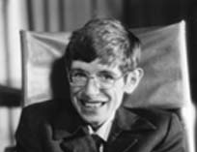
This physicist calculated that black holes should emit radiation until they evaporate. He is almost completely paralyzed from ALS, or Lou Gehrig’s disease.
What’s in a Name - 100

Slide 14
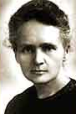
The Nobel Prizes in Chemistry has been given to 3 women. This woman and her daughter each received one for work on radioactivity.
What’s in a Name - 200

Slide 15
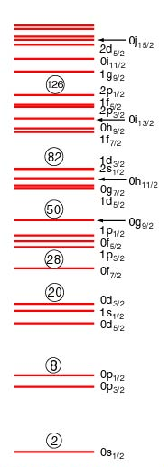
The second female to win a Nobel Prize in physics, Maria Goeppert-Mayer, won for this model.
What’s in a Name - 300

Slide 16
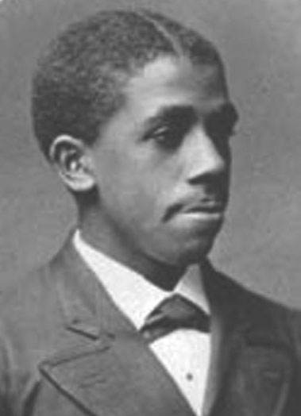
By approving Edward Bouchet’s dissertation “On Measuring Refractive Indices”, this ivy league school because the first American university to grant a PhD to an African American.
What’s in a Name - 400

Slide 17
This iconic physicist was engaged in many civil rights activities and co-chaired the American Crusade to End Lynching.
What’s in a Name - 500

Slide 18
This planet has the highest mean surface temperature.
Extreme Planets - 100

Slide 19
This former planet has a moon nearly half its diameter in size.
Extreme Planets - 200

Slide 20
This planet has the largest angular momentum about our sun.
Extreme Planets - 300

Slide 21
Of the 8 official planets, it could almost be considered a double planet, with the largest moon relative to its size.
Extreme Planets - 400

Slide 22
Galileo described this lowest density planet as having "ears".
Extreme Planets - 500

Slide 23

In this 1997 film, based on a book by astronomer Carl Sagan, Jodi Foster’s character meets extraterrestrial beings.
Pop Culture - 100

Slide 24

This new CBS sitcom revolves around two theoretical physicists and their pretty neighbor.
Pop Culture - 200

Slide 25

Physicist Lawrence Krauss wrote this popular “physics of” book for Voyager fans.
Pop Culture - 300

Slide 26

The guitarist from this legendary English band recently defended his PhD work in astrophysics.
Pop Culture - 400

Slide 27

John Lithgow played a physics professor in this wacky NBC sitcom (1996-2001).
Pop Culture - 500

Slide 28
DAILY DOUBLE
Make your wager now…

