Slide 1
Conducting Outreach – Best Practices for Undergraduate Students

Slide 2
Overview
Importance of Outreach
Planning a Successful Outreach Event
Outreach Demo Resources

Slide 3
SPS Statement on Outreach
Outreach inspires scientific literacy while promoting public understanding of the benefits of physics education and research. Community and educational partnerships also foster curiosity and passion in the next generation. These activities enrich the experience of the participating undergraduate students as ambassadors of science by promoting a deeper commitment to their discipline.
Read the full Statement here

Slide 4
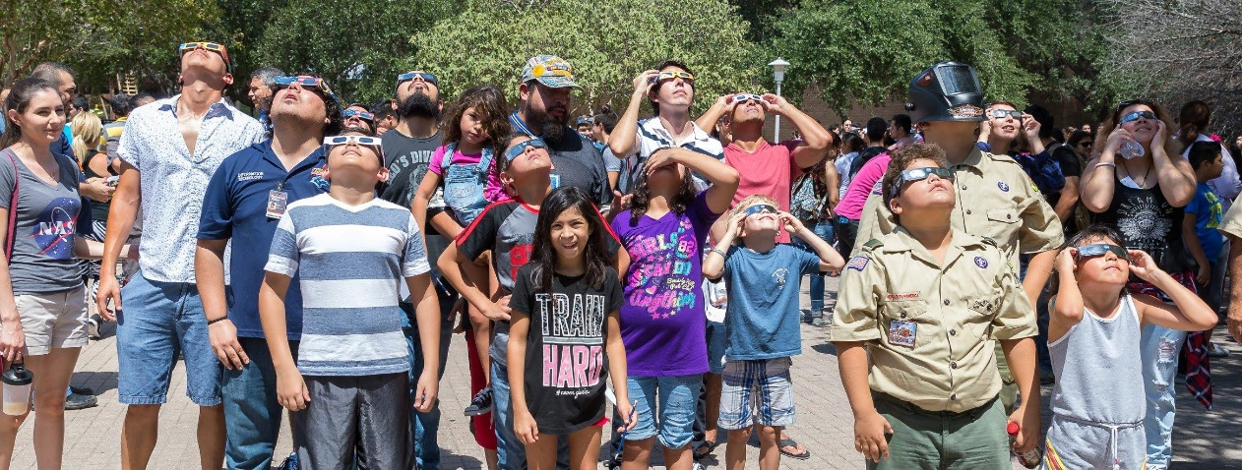
Benefits of Outreach
Benefits to your department/SPS chapter
Foster strong community relationships
Good P.R.
Increase funding opportunities
Build pipeline of future physics and astronomy majors
Supports/improves interdepartmental fellowship

Slide 5
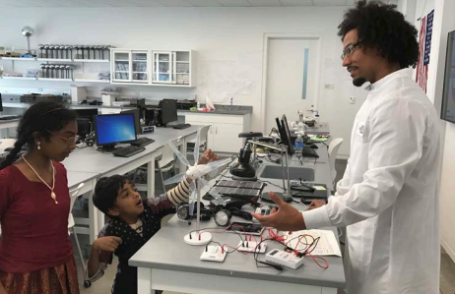
Benefits of Outreach
Benefits to YOU!
Opportunities to instill wonder and inspire the next generation of physicists!
Further understanding of physics concepts
Expand professional network
Develop interpersonal skills
Communication
Problem solving &
critical thinking

Slide 6
Planning & Logistics
Identify your audience
Education level
Number of attendees
Topic of interest
Volunteer needs
1 per every 4 students
Volunteer permissions
Locating a venue
On campus, school, museum, observatory, community center
Materials
Plan early!
Make and takes vs. standing demo
AV/electrical needs

Slide 7
Planning & Logistics
Fundraising, Fundraising, Fundraising…
Ideas for fundraising
Sell coffee & donuts, or pizza & soda during high traffic periods (like finals week)
Tutor for STEM courses on-campus & at local schools
Contact school development office for potential sponsorships
Work with alumni network
Find more fundraising ideas here.

Slide 8
Planning & Logistics
Communications Plan
Advertise early
Social media/website promotion
Contact school administrators/teachers directly
Partnerships
On-campus student groups
Campus resources
Library & museum
News & media
Industry

Slide 9
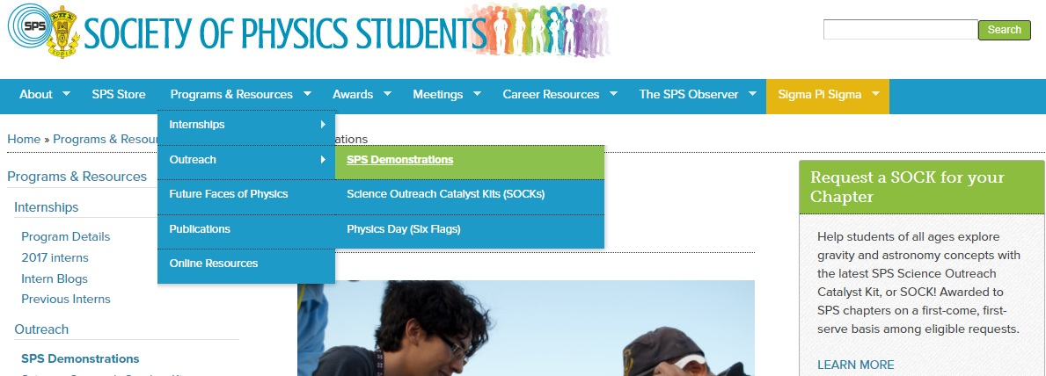
SPS Outreach Resources
SPS Demonstration page
Access over 20 outreach demos for all ages
Low cost
Each demo page includes:
Audience level
Time needed
Presenter notes
Supplies list
Demo videos

Slide 10
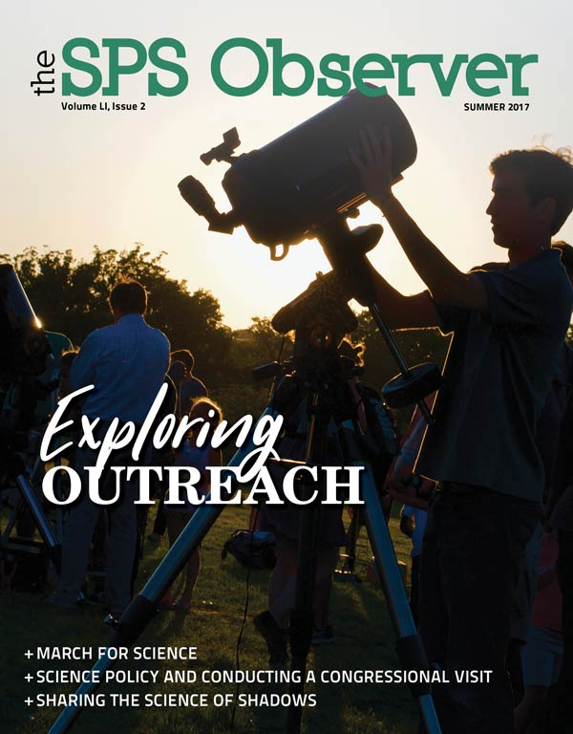
SPS Outreach Resources
SPS Observer
Summer 2017 issue:
Exploring Outreach
SPS Outreach Awards
Future Faces of Physics
Awarded to chapters for physics outreach to promote physics across cultures
Marsh W. White
Awarded to chapters for physics outreach to K-12 and the general public

Slide 11
SPS Outreach Resources
Science Outreach Catalyst Kits (S.O.C.K)
Free kits containing supplies to perform outreach demos
Themes vary by year; past topics include:
Fabric of the Universe, Sensors, Light, and Sound
SOCKs can be requested through the SPS National website
See this year’s SOCK theme here.

